Slide 1
IOT BASED HOME AUTOMATION SYSTEM
BE19F04F001 TRUPTI DEORE
BE19FO4F005 RUSHIKESH GUNJAL
BE19F04F009 POOJA THORAT

Slide 2
Contents
Introduction
Features of home automation
System hardware block diagram
Methodology
Working technique
Conclusion
Advantages and Application
Future scope
References
Picture gallery

Slide 3
INTRODUCTION
Home automation is also named as domestics or Smart home
It involves the control and automation of lighting, heating, ventilation, air conditioning and security, as well as home appliances. Wi-Fi is often used for remote monitoring and control
We can decrease the electricity gross electricity wasted electricity year by turning off our home appliances when not in use
So, any small device/technology that would help them switch their lights on or off, or play their favorite music etc
Hence, the need for finding an inexpensive and smart assistant for normal families keeps growing.

Slide 4
FEATURES OF HOME AUTOMATION SYSTEM
Reduced Installation costs
Internet Connectivity
Scalable and Expandable
Security

Slide 5
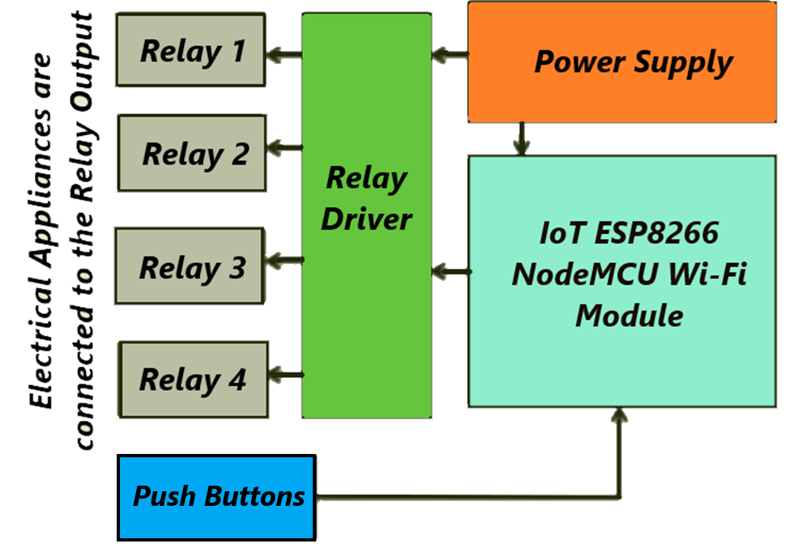
System Hardware Block Diagram:

Slide 6
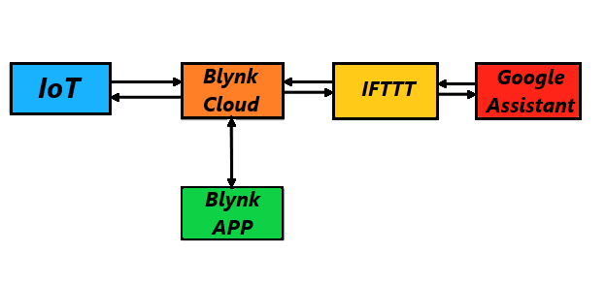
Block diagram:

Slide 7
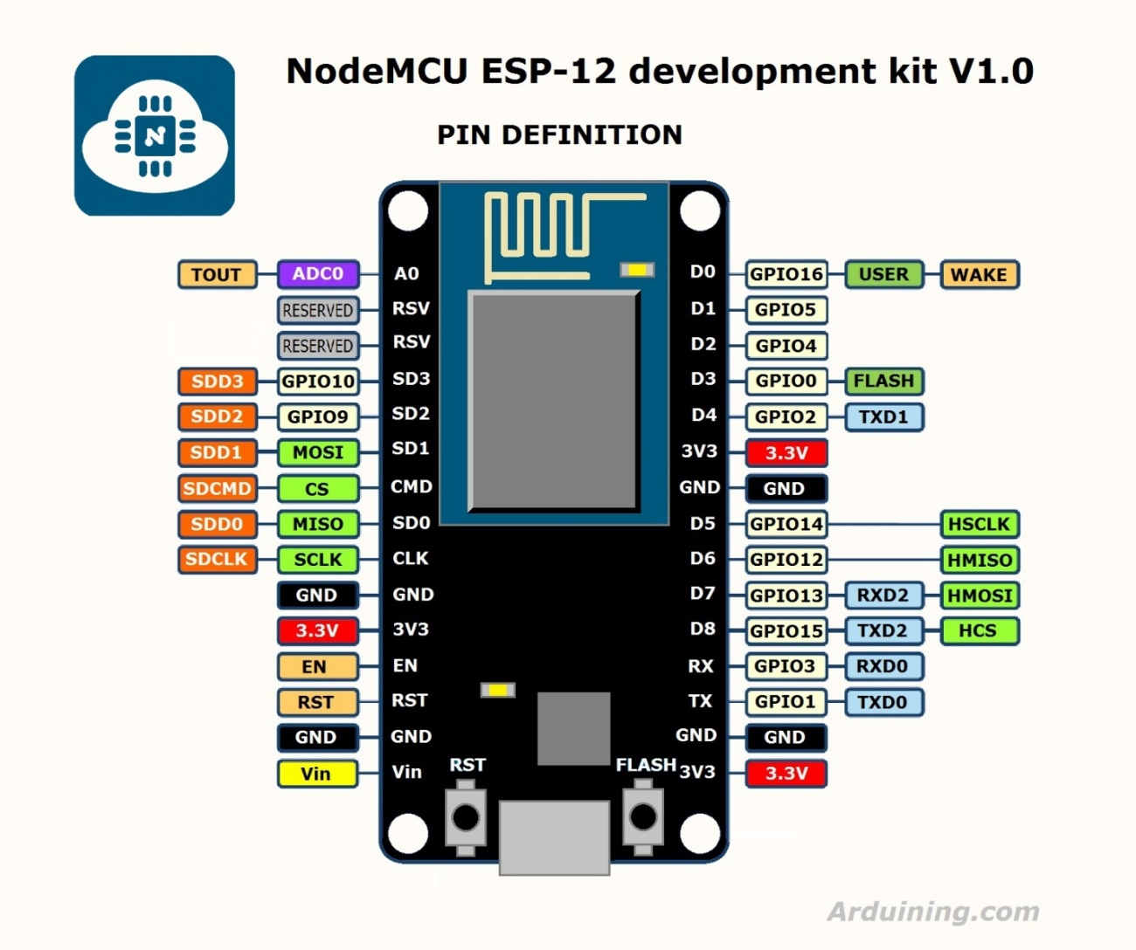
METHEDOLOGY OF NODE MSU

Slide 8
SPECIFICATION OF NODE MCU
Voltage:3.3V.
Wi-Fi Direct (P2P), soft-AP.
Current consumption: 10uA~170mA.
Flash memory attachable: 16MB max (512K normal).
Integrated TCP/IP protocol stack.
Processor: Tensilica L106 32-bit.
Processor speed: 80~160MHz.
RAM: 32K + 80K.
GPIOs: 17 (multiplexed with other functions).
Analog to Digital: 1 input with 1024 step resolution.
+19.5dBm output power in 802.11b mode
802.11 support: b/g/n.
Maximum concurrent TCP connections: 5.

Slide 9
FEATURES OF BLYNK APP
Similar API & UI for all supported hardware & devices
Connection to the cloud using:
Wi-Fi
Bluetooth and BLE
Ethernet
USB (Serial)
GSM Set of easy-to-use Widgets
Direct pin manipulation with no code writing
Easy to integrate and add new functionality using virtual pins
History data monitoring via Super Chart widget
Device-to-Device communication using Bridge Widget
Sending emails, tweets, push notifications, etc.

Slide 10
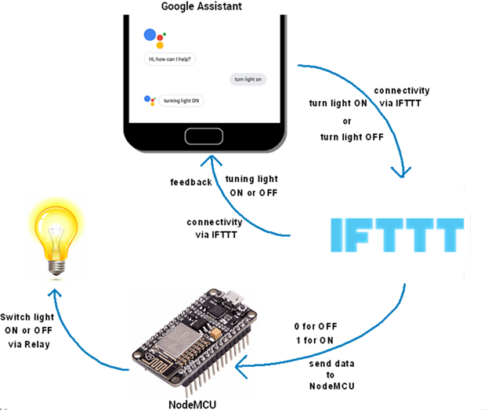
WORKING TECHNIQUE

Slide 11
CONCLUSION
Uses friendly system.
This system is highly reliable and efficient for the aged person and paralyzed person on the wheel chair who cannot reach the switch for the switching of on /off and controlling the device and are dependent on other this system has a wide scope development and modification.
Turning ON and OFF of home appliances are done by giving Voice Commands to Google Assistant simply using smartphone. Also, the temperature and humidity are displayed

Slide 12
ADVANTAGES
Save Money
Saves Time
Convenience
Safety

Slide 13
REFERENCE
www.circuitdigest.com
www.microcontrollerslab.com
www.electronicsshub.org
www.electronicsforu.com
www.pantechsolutions.com

Slide 14
FUTURE SCOPE
As many GPIO pins of ESP8266 Node MCU is still unused.
The instructions sent in an SMS from a cellular phone
More devices can be simulated and timer could be set for automatic operation
Artificial Intelligence, high speed internet smart phones and remote access to the housing system will lead to convenience and safety of house by security concerns will also arise.
Proper use and development in this field will fulfill uor requirement and make our lives easy….!!!

Slide 15
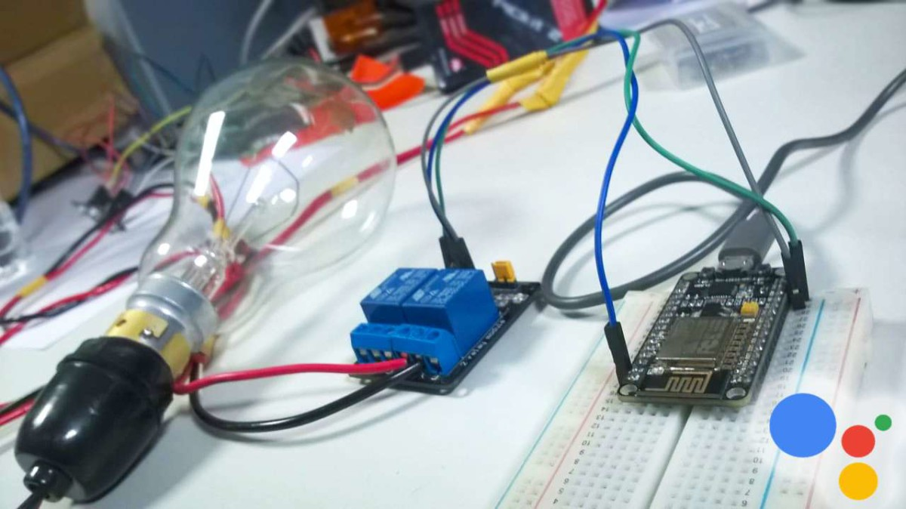
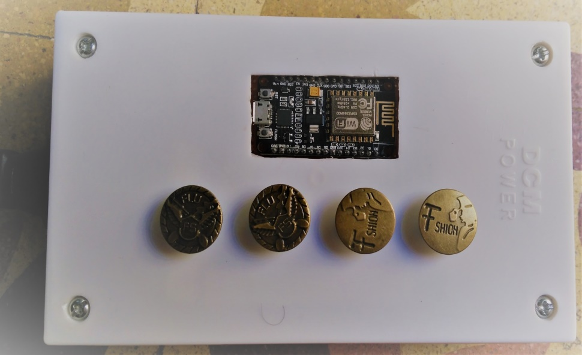
Picture Gallery

